Slide 1
Introducing Dictionaries
An easily searchable Way to store multiple elements

Slide 2
Dictionaries: Indexed Collections of Data
Dictionaries are data structures that store data as a pairing – a key and its value.
Value is mapped to a specific key
Key and value don’t need to be the same type of thing
To search for a value, provide the key
Dictionary will look through its data to find the value mapped to that key
Relationship between the key and its value is known as the mapping
Mappings are usually 1:1
Key | Value
Alvin | 084-7789534
Simon | 082-5412569
Theodore | 085-7548123
Bow | 086-8794582
Glimmer | 087-7852164
Razz | 085-8954671

Slide 3
Examples of Dictionaries
A dictionary
Key: The word you wish to find
Value: The definition of that word
A phone book
Key: The contact’s name
Value: The contact’s phone number (plus other optional contact info)

Slide 4
Dictionary Terminology
Key: The information used to locate a piece of data within the dictionary
Must be a unique value – equivalent of primary key in a database
Must be an immutable type
Value: The data stored under a specific key
May be a duplicate
Can be changed at will
Item: A key-value pairing

Slide 5
What Can Dictionaries Hold?
Values can be any type
Keys can be any immutable type
Immutable: unable to change
Examples of immutable types: strings, tuples, integers, etc
Keys must be immutable as they are the only way to find a value within a dictionary
If a key was changed, how would you find its corresponding value again?

Slide 6

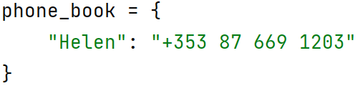
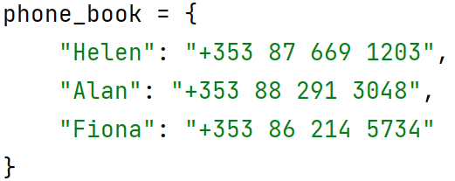
Creating Dictionaries
We can create an empty dictionary:
dictionary_name = {}
We can create a dictionary containing a single key-value pair
Key and value are separated by a colon!
dictionary_name = { key: value }
We can create a dictionary containing more than one pair
Pairs are separated by commas!
dictionary_name = { key: value, key1: value2, key2: value3 }
Contains no items
Contains one item
Contains three items
Use curly brackets to create dictionaries!

Slide 7
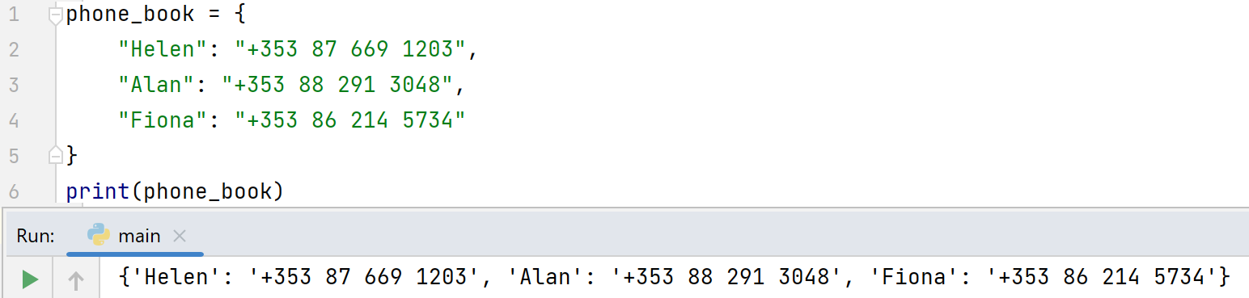
Displaying Dictionaries
We can display a whole dictionary by using print() as normal
We may want to display each item on a separate line, or do more formatting – to do this we need to know a bit more about how to work with a dictionary
Note the formatting of the dictionary definition:
New line for each item
Curly brackets closed on new line

Slide 8
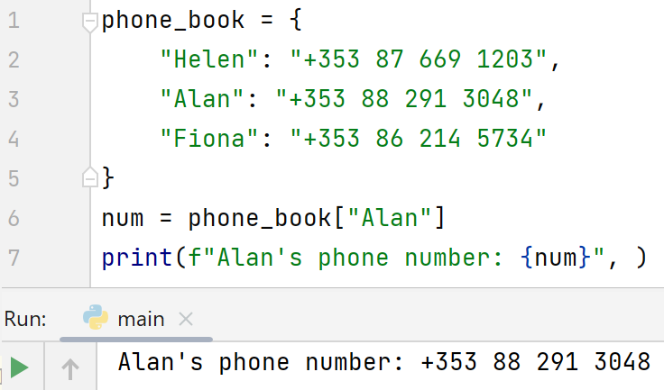
Retrieving From Dictionaries – Retrieving a Specific Element
We need to be able to retrieve a specific value from a dictionary
Unlike lists and tuples, we do NOT use an index/position here.
To get a value from a dictionary, we use the dictionary’s name with the key of the data we’re seeking in square brackets []
Syntax: dictionary_name[key]
If the key is not present, a KeyError is thrown
“Safe” alternative: the get() method
This returns a None* if no match is found
Notes:
*We’ll see more on this in a couple of slides

Slide 9
Retrieving from Dictionaries – Retrieving All Items
Three possible approaches to accessing all items in a dictionary:
Getting the list of all keys: dictionary_name.keys()
Getting the list of all values: dictionary_name.values()
Getting the list of all items (key-value pairs) as tuples: dictionary_name.items()

Slide 10
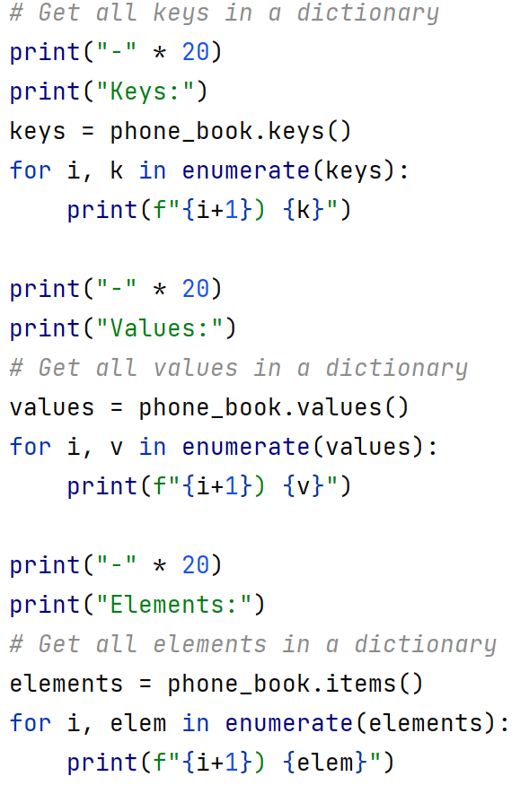
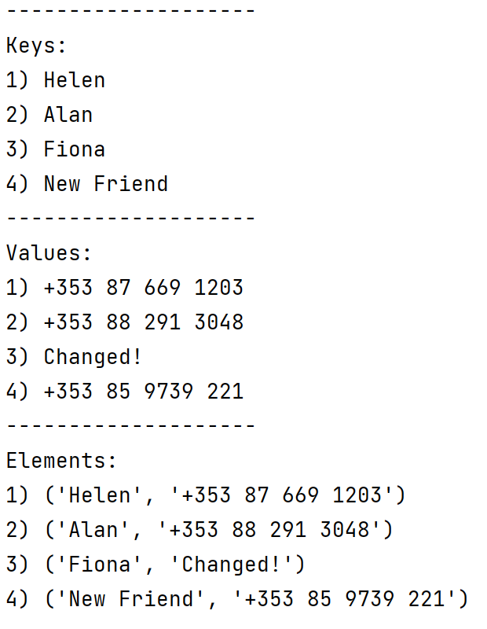
Example: Using keys(), values() and items()
Commented version on moodle:
introducing_dictionaries.py

Slide 11
Adding to Dictionaries
The default way to add to a dictionary is to act as though the key is already there!
Updating a value and adding a key-value pair are done in the same way
Syntax: dictionary_name[key] = value
If the key is not already present, it will be added as a pair with the value
If the key is already present, its existing value will be replaced with this one
Adding a new element
Updating an existing element

Slide 12
A Word of Caution…
A potential danger when adding elements to a dictionary is that if the key already exists, the old value is deleted
What could/should you do to avoid this?

Slide 13
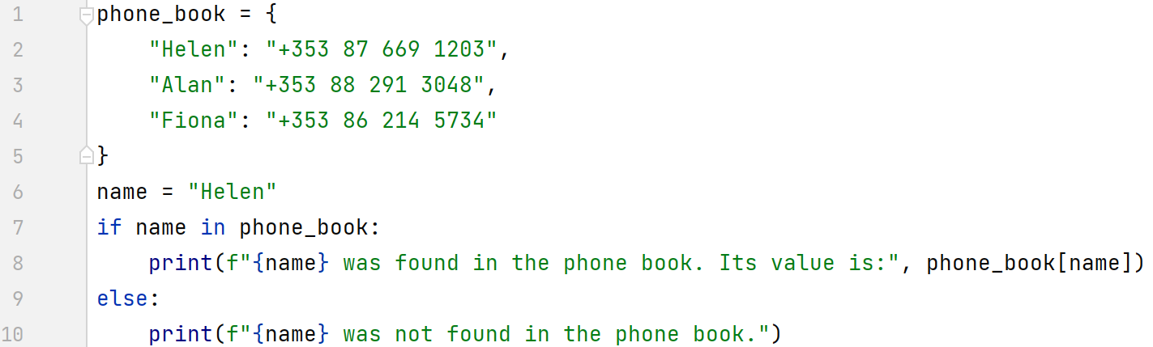
Checking if a Key is in a Dictionary
Sometimes you want to know if a key already exists within a dictionary
Not its value, just if it’s there at all
To do this, you use the in operator
Syntax: key in dictionary_name
Commented version on moodle:
checking_if_in_dict.py
Remember: Keys must match EXACTLY!

Slide 14
Checking if a Key is NOT in a Dictionary
Sometimes you want to know if something isn’t present in a dictionary
Again, not worried about its value, just that it’s not there at all
To do this, you use not in operator
Syntax: key not in dictionary_name
Commented version on moodle:
checking_if_in_dict.py

Slide 15
Exercise: Validating Information
Amend the code in introducing_dictionaries.py to ask the user to enter a friend’s name and contact number.
Validate that the name does not already exist as a key before adding it to the dictionary.
While it’s not a unique name:
Prompt the user to re-enter the name
Check the new version to see if it’s unique
When a valid name is given, add it to the dictionary

Slide 16
Removing From Dictionaries
When we think about removing from a dictionary, we need to consider:
Do we want to remove the whole element, i.e. the key AND value?
Do we want to wipe the value out but keep the key?
Removing the whole element indicates the key isn’t likely to be used again
It also stops confusion over whether the key is available, e.g. with usernames
Wiping out just the value indicates you expect to get a new value for that key later

Slide 17
Removing From Dictionaries: Option 1) Removing the Complete Item
To remove a complete item (key-value pair) from a dictionary you use the pop() function
dictionary_name.pop(key)
pop() will:
Delete the specified key and its corresponding value
Return the value that was deleted (not the key-value pair – why?)
If there is no item with the specified key, pop() will throw a KeyError
To avoid this, you can specify a default return value, e.g.:
dictionary_name.pop(key, None)
Anything can be supplied as the second parameter, not just None

Slide 18
Removing From Dictionaries: Option 2) Keeping a Key, Wiping its Value
To wipe the value, we need to set it to a null state (i.e. containing nothing)
dictionary_name[key] = <Some blank / nothing value>
How do we show “nothing”?
“” is still a piece of text
0 is still a number
True/False are still Boolean values
In Python, None indicates nothing
Setting something to None means no confusion over whether a value is “real”
Commented example on moodle:
wiping_values.py

Slide 19
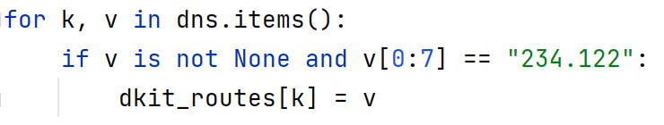
Side Topic: The Issue With None
Positive: None can be a great way to indicate no result/invalid information
Very clear that no possible answer can be provided
Drawback: When you use None in your programs, you are no longer guaranteed about the type of information you’re working with
None is not an int, float, bool or string, it’s its own thing
You need to remember to check it before you try to work with your data
If you don’t, you run the risk of a TypeError:
To check for None, you use the is / is not operators
Commented example on moodle: wiping_values.py
Without this check, you could get a TypeError

Slide 20
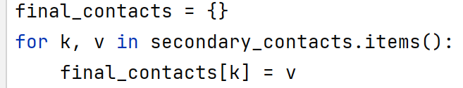
Updating Dictionaries
Adding/updating a single entry in a dictionary is easy:
Remember: dictionary_name[key] = value
What if we want to:
Add multiple new items (key-value pairs)
Update a dictionary to ensure its values are the most recent
Combine two dictionaries
We can use the original approach, but it means we need to loop:
Takes everything from secondary_contacts and adds to final_contacts

Slide 21
Updating Dictionaries: Batch Updating!
To update/add more than one item in a dictionary without looping, we can use update()
dict_name.update(x):
Takes in an iterable* of items (in our case, a dictionary)
Adds in all items where the key is not already in the dictionary
Updates (changes the value of) any items where the key is already in the dictionary
Warning: update will overwrite values of any existing keys!
If you don’t want to lose old value information, you need to do some extra processing
Uh oh!
Commented example on moodle:
UsingUpdate.py
Notes:
* We’re going to talk more about iterables in future. At the moment, think of them as things that can be looped through/iterated over.

Slide 22
Review: Useful Dictionary Functions
keys() – Gets a list of all keys stored in the dictionary
values() – Gets a list of all values stored in the dictionary
items() – Gets a list of all items (key-value pairs)
Each key-value pair is formatted as a tuple
pop() – Delete an item (key-value pair) from the dictionary
Takes the key to be deleted as a parameter
Throws a KeyError if no item is found matching the supplied key
popitem() – Delete the last item (key-value pair) added to the dictionary
Takes no parameters, always deletes the last item that was added
update() – Add one or more items (key-value pairs) to the dictionary
Where a key exists already, its corresponding value is overwritten (with no notification!)
clear() – Wipes the dictionary of all entries

Slide 23
Some Useful Functions That Use Dictionaries
The functions on the previous slides are called by the dictionary in question
The function is called on the dictionary: dictionary_name.function_name()
There are some other useful functions that take a dictionary as a parameter:
len – get the number of elements in a dictionary : len(dictionary_name)
max – get the largest key in a dictionary : max(dictionary_name)
min – get the smallest key in a dictionary : min(dictionary_name)

